Slide 1
Build Day!

Slide 2
Essential Questions
01
02
What are the roles of each electronic within this sensor?
How do we test and validate this sensor before deployment?

Slide 3
Learning Outcomes
I can:
Explain how basic electronic components work together in a circuit.
Describe how a microcontroller reads, processes, and follows code instructions.
Build and assemble a simple rainfall and water-level sensor.
Test and evaluate how well the OWLR (Open Water Level + Rain) sensor works.
Explore and interpret real-world data collected by the OWLR sensor.

Slide 4
Agenda
Investigate
Build
Plan

Slide 5
Investigate

Slide 6
What is an environmental sensor?
Where have you seen them?
Think about what it involves to build a low-cost reliable sensor?
Notes:
May need to start more broad with can anyone name a sensor? Ideas of cost? Is all data open for the public?

Slide 7
Let’s explore the electronics we will be using!
Notes:
Note: Students can be encouraged to think beyond their individual dwelling to their neighborhood and community, including the people, the natural world, the climate, the geography, the built environment, the activities, including seasonal hobbies, sports, festivals, holiday celebrations, etc.

Slide 8
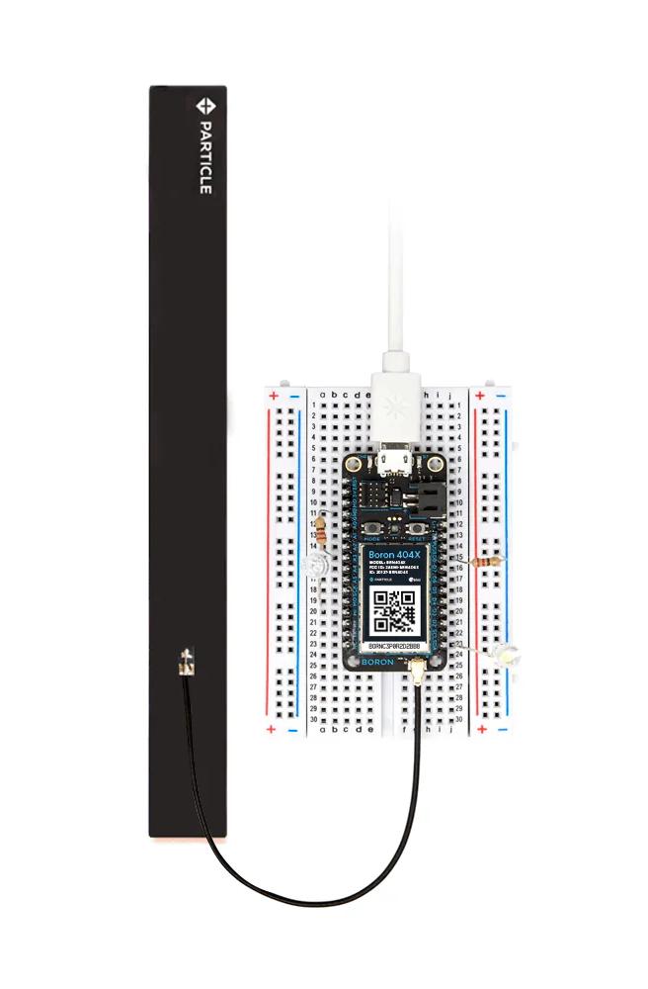
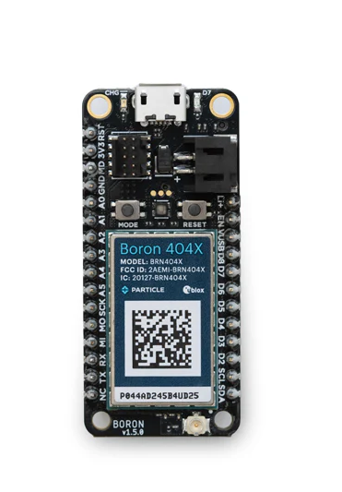
Microcontroller
Purpose:
Acts as a small sustained computer chip
Designed to manage specific tasks
Able to communicate and handle input from accessory electronics (sensors in our case).
We chose:
Company is Particle and we use their Boron microcontroller
$50
Include an antenna for us to use cellular!
Why could this be important?
Notes:
Alternative prompt: How does the place where you live impact your personal and cultural identity and well-being?
Teacher or students can record some class notes to refer back to during the Investigate section case study.

Slide 9
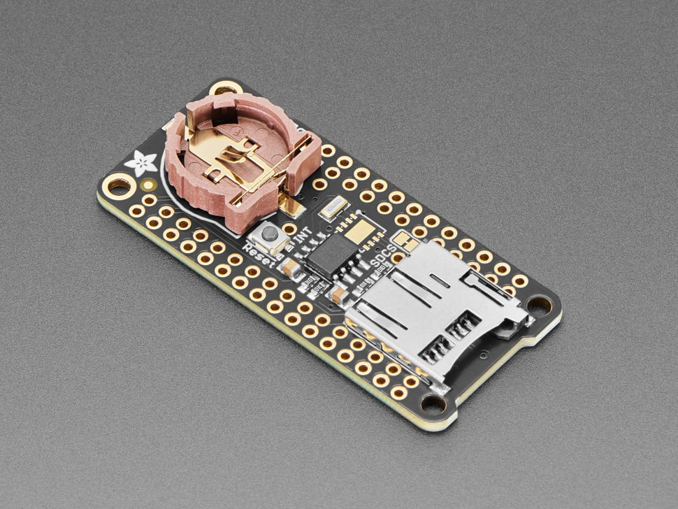
2. SD Data Logger
Purpose:
Local storage
We chose:
Company is Adafruit
$8.95
Why might this be important?
Notes:
Alternative prompt: How does the place where you live impact your personal and cultural identity and well-being?
Teacher or students can record some class notes to refer back to during the Investigate section case study.

Slide 10
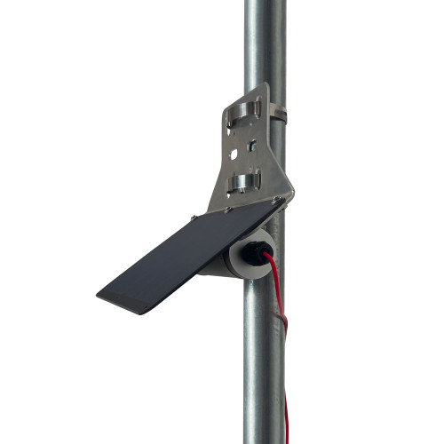
3. Solar Panel + Battery Pack
Purpose:
We can use solar energy!
We chose:
Company is Voltaic
$150
Why might this be important?
Notes:
Alternative prompt: How does the place where you live impact your personal and cultural identity and well-being?
Teacher or students can record some class notes to refer back to during the Investigate section case study.

Slide 11
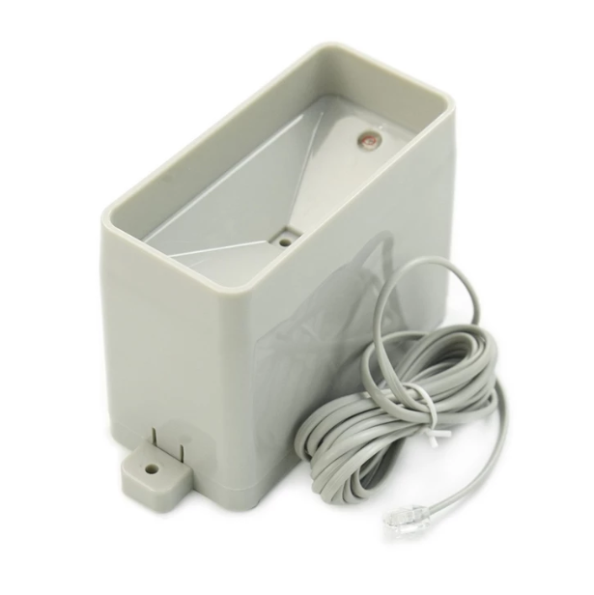
3. Rainfall Tipping Bucket
Purpose:
Collect rainfall data using a tipping bucket mechanism
We chose:
Company is DFRobot
$30
What could be the issue with this instrument?
Notes:
Alternative prompt: How does the place where you live impact your personal and cultural identity and well-being?
Teacher or students can record some class notes to refer back to during the Investigate section case study.

Slide 12
Let’s explore what we should consider with housing
Notes:
Note: Students can be encouraged to think beyond their individual dwelling to their neighborhood and community, including the people, the natural world, the climate, the geography, the built environment, the activities, including seasonal hobbies, sports, festivals, holiday celebrations, etc.

Slide 13
Let’s explore what we should consider with housing
Durable
Low-Cost
Simple
Waterproof
Notes:
Note: Students can be encouraged to think beyond their individual dwelling to their neighborhood and community, including the people, the natural world, the climate, the geography, the built environment, the activities, including seasonal hobbies, sports, festivals, holiday celebrations, etc.

Slide 14
INVESTIGATE
≅50 minutes

Slide 15
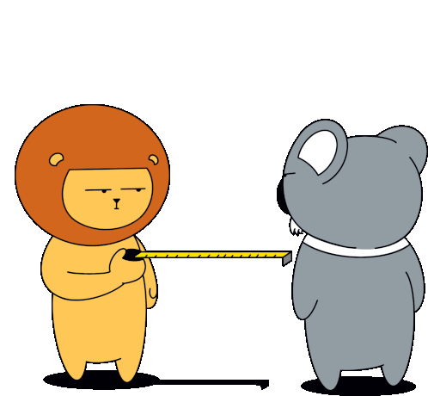
Distance Sensor Activity

Slide 16
Activity Steps:
Receive electronics in 4 groups
You will receive a boron, OLED Display board, and a distance sensor.
Test that sensor at 10 measured locations between 50cm - 300cm (requires a ruler or measurement stick).
Log the ADC value to see on the screen and the correlating measurement.
Convert the ADC units to useful values in centimeters by multiplying by .25
Create a comparison plot of what you measured vs. what the sensor detected.
Questions:
How accurate is this distance sensor?
HARD QUESTION: How would I determine water level using this sensor?

Slide 17
Activity Steps:
Receive electronics in 4 groups
You will receive a boron, OLED Display board, and a distance sensor.
Your job is to plot the ADC values you see on the OLED compared to actual measurements.
Test that sensor at 10 measured locations between 50cm - 300cm (requires a ruler or measurement stick).
Plot actual measurement vs. ADC to determine the conversion factor between these two values.
Questions:
How accurate is this distance sensor?
HARD QUESTION: How would I determine water level using this sensor?

Slide 18
Discuss

Slide 19

Discussion
What were some things that stuck out from the day?
What was easy?
What was difficult?
What would you do if you were to do this again?
Notes:
Get more into precise with questions.
What do I want them to know after the experience?? How precise is distance sensor? What is dangerous about an imprecise data point? Data is usually trusted at face value so we need to make sure its right.
This is why we use code!

Slide 20
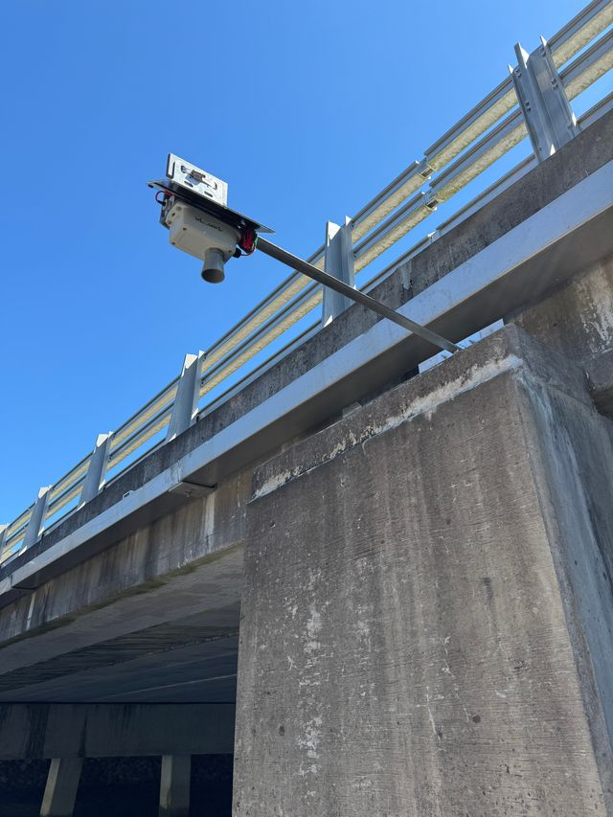
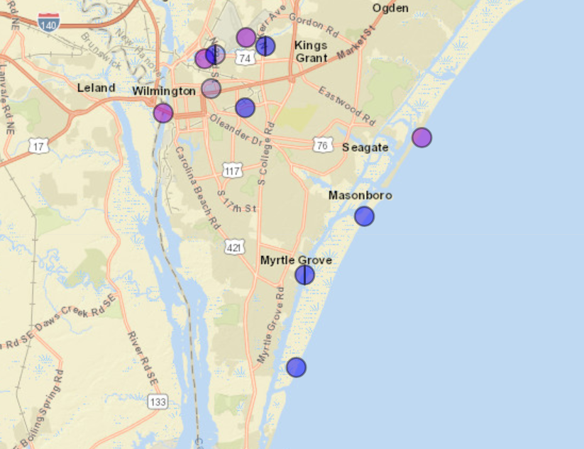
Example Data from Wilmington, NC
Let’s Explore!
https://wl.cormp.org/
Notes:
Create print out for looking at data.

Slide 21
Explore Data
Group 1: BMC-RAND-WL
Group 2: Love Grove Bridge
Group 3: SMC-KERR-WL
Group 4: CMSDOCK_WL
Choosing a 1-3 month period explore…
What is the highest and lowest water level you see (in cm)?
What are some trends you see, what could be causing them?
Are there any large precipitation events within your time frame?

Slide 22
Next Class!
Deployment!
Stormwater Control Evaluation
Final poster discussion

